Slide 1
Full Stack Development Project topic: CARRIDE

Slide 2

Hello!
I am Vikash Mishra
I am here to give a presentation on the website I have build , you can find me at vikashm1999@gmail.com
& https://www.linkedin.com/in/vikashmishra9
<number>

Slide 3




Technology implemented are:
1.Html
2.Javascript
3.Css
4.Bootstrap

Slide 4
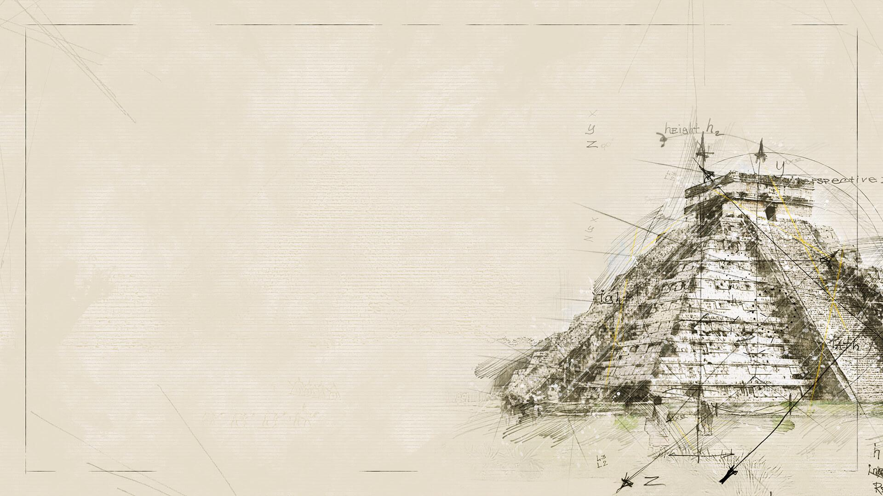
Imagination is more important than knowledge. ~Albert Einstein
<number>

Slide 5

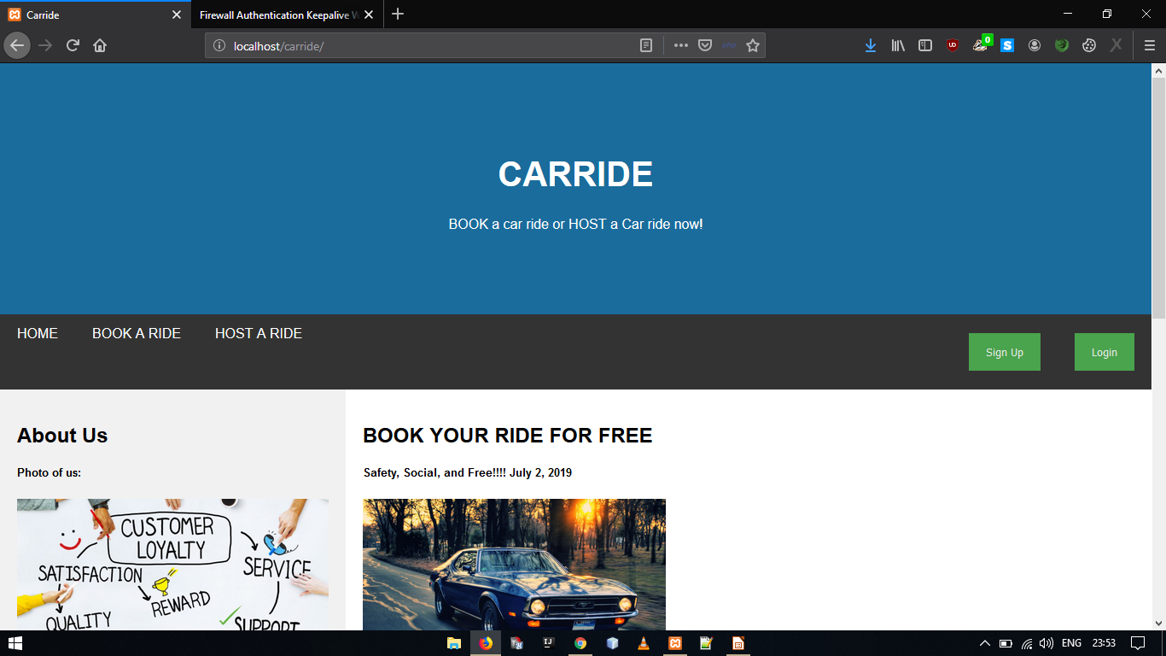
INDEX PAGE:
<number>

Slide 6
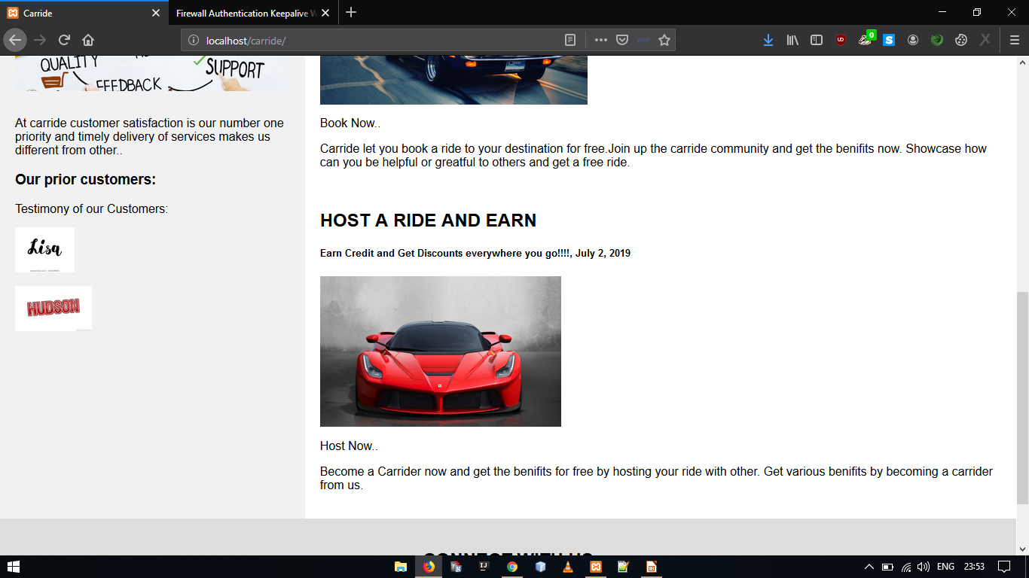
Continued.....

Slide 7

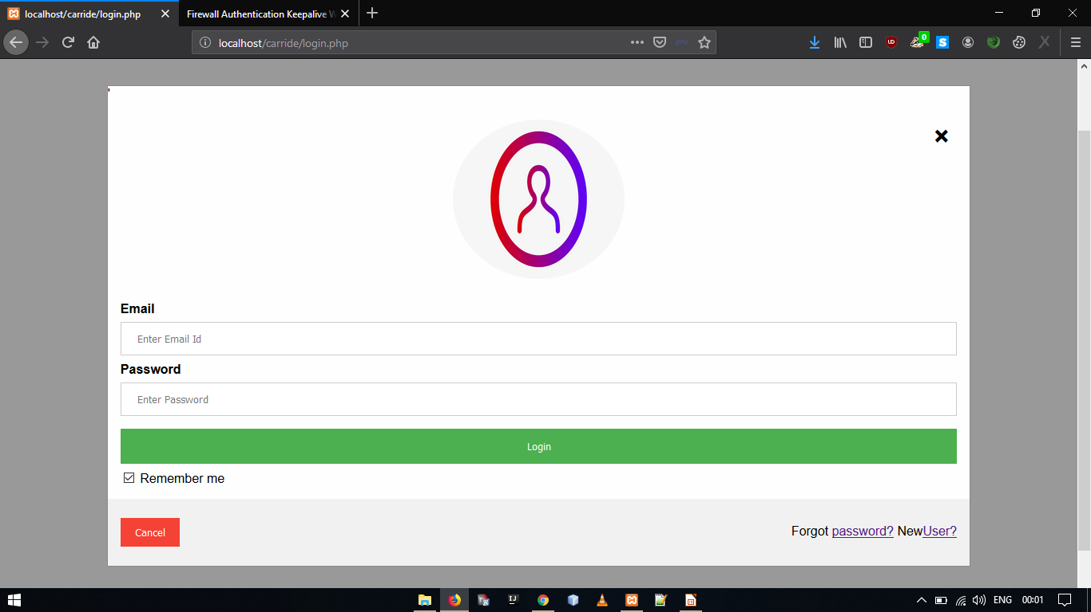
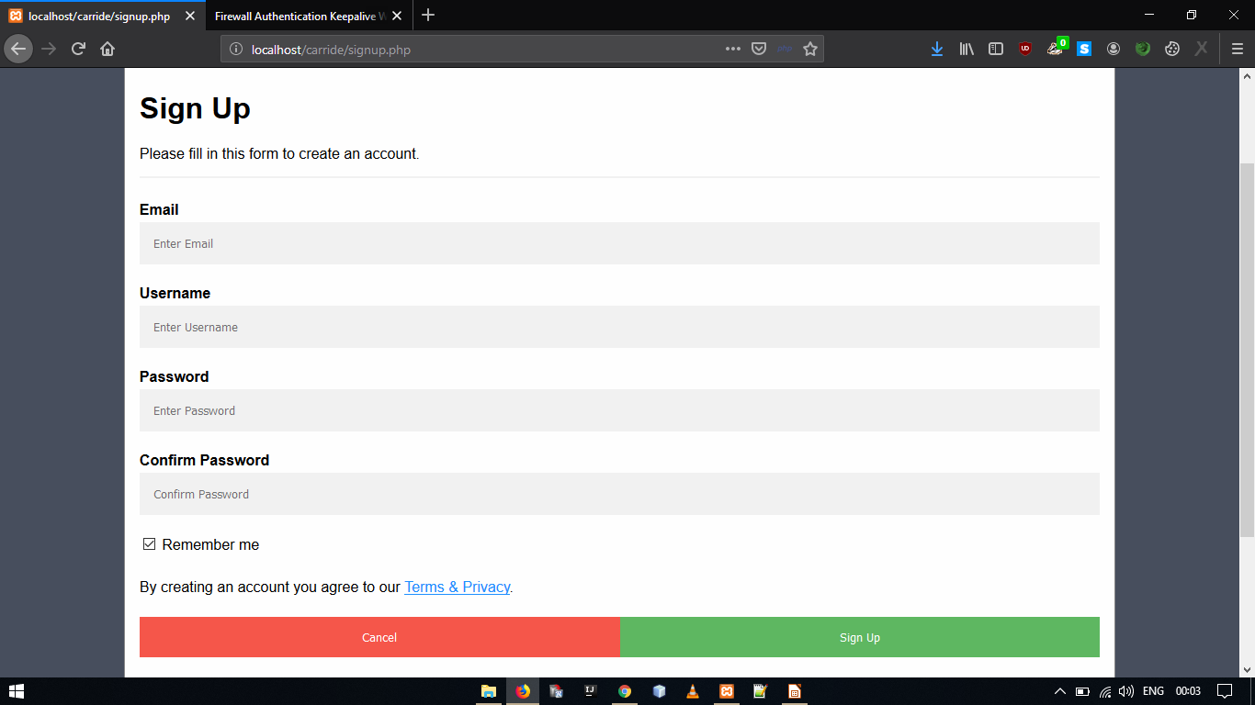
Login page | Sign up Page
<number>

Slide 8
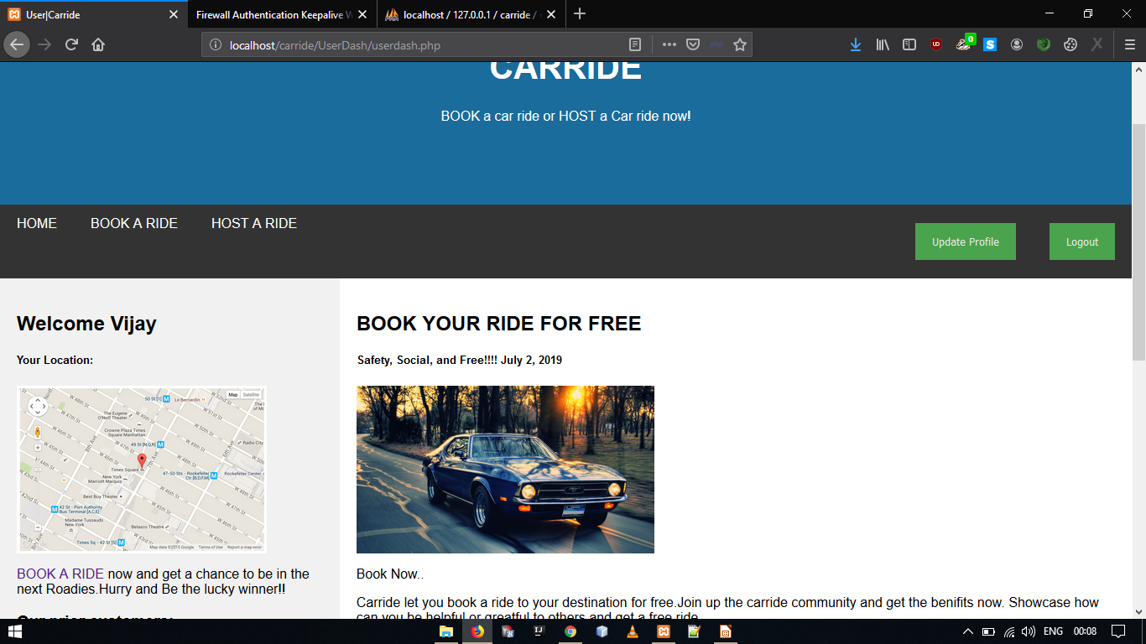
UserDash

Slide 9
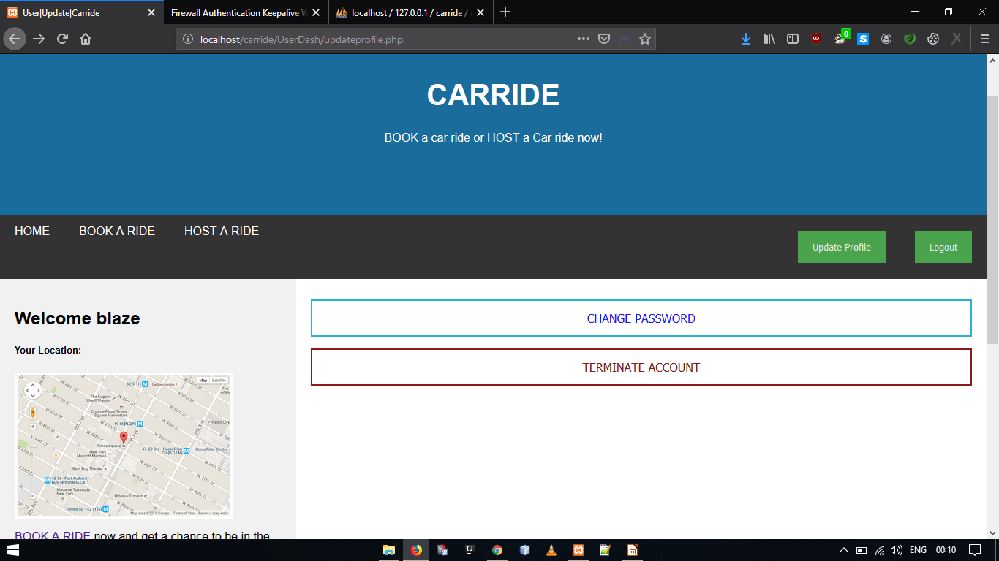
Update Page:

Slide 10
Use diagrams to explain your ideas
HOME
User/Login
Guest
Book/Host Ride
Update/Terminate Profile
Register
Book Ride
<number>

Slide 11

Thanks!
Any questions?
You can find me at:
+917258920656
vikashm1999@gmail.com
<number>

Slide 12

Credits
Special thanks to Mr. Dilip Giri Sir from ICT team to be ever present to help in hours of need.
<number>

